Slide 1

Pharma Success: Dashboard-Driven Strategy AKASH LALWANI Gaurav Jangid

Slide 2
Rationale
Strategy Decision Making
Complexity of pharmaceutical data
User friendly interface
Diverse analytical perspectives

Slide 3

Presentation flow
Strategy Development
Objectives
Pharmaceutical Sales Dataset
Link to the Dashboard
Dashboard Insights
Conclusion
Code

Slide 4
What is strategy Development?

Slide 5

Components of strategy development
“Strategy development refers to the process of formulating and implementing plans and actions that enable a pharmaceutical company to achieve its objectives, stay competitive, and succeed in a dynamic and complex environment “
Market Research
Portfolio Management
Global Expansion
Supply Chain Optimization
Risk Management

Slide 6
Objectives
Understand the complexity of Pharmaceutical Dataset
Develop a user-friendly Dashboard using R shiny
Identifying trends and patterns
Give recommendations based on analysis

Slide 7
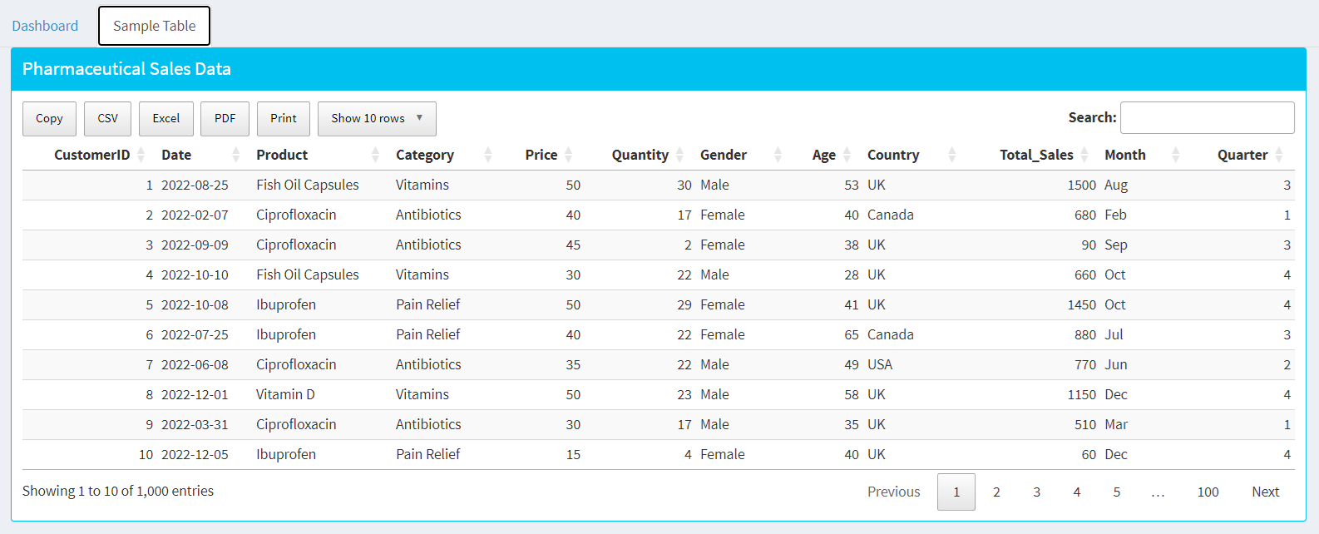
Pharmaceutical Sales Data Table:
Insight for Strategy: Detailed information on individual sales transactions.
Use Case: Investigate specific transactions for anomalies or patterns. Identify successful product launches or underperforming products. Use transaction-level details for targeted decision-making.

Slide 8
Link to the dashboard
Pharmaceutical Sales Dashboard

Slide 9
Insights from Dashboard and its application in strategy development

Slide 10
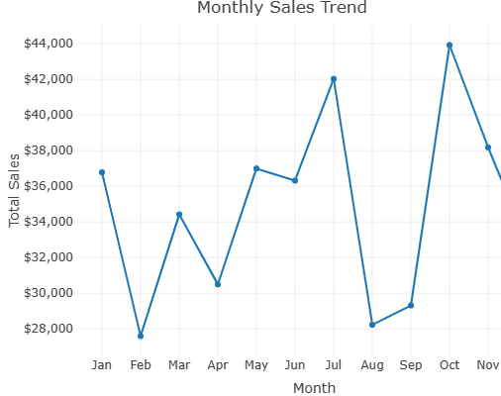
Identification of peak sales month
Analysis - Peak sales months- July and October
Recommendations -
Plan marketing campaigns or promotions during high-sales months.
Adjust inventory levels and production schedules to meet increased demand during specific seasons.
Scope of investments in off seasonal month.

Slide 11
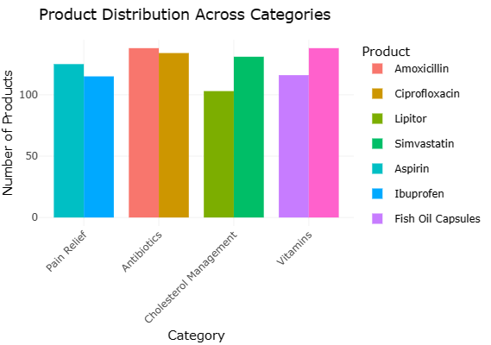
Identifying Product Popularity in different Categories
Analysis –
Aspirin is more popular than ibuprofen.
In Antibiotics both products have almost same demand.
Recommendation -
Allocate resources and marketing efforts strategically.
Focus on promoting products that are popular in their respective categories.
Scope of improvement for unpopular products.
Consider cross-promotions to boost sales of related products

Slide 12
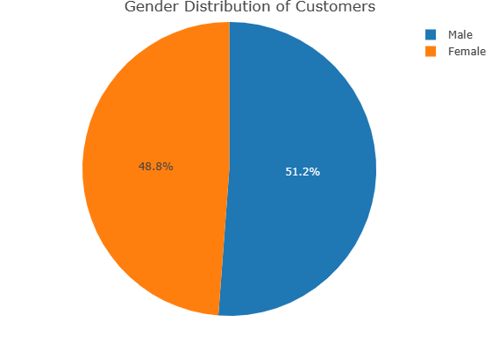
Identifying Gender distribution of Customers
Analysis – No significant difference in demand w.r.t gender
Recommendation -
Scope to introduce gender-specific product to command premium pricing.

Slide 13
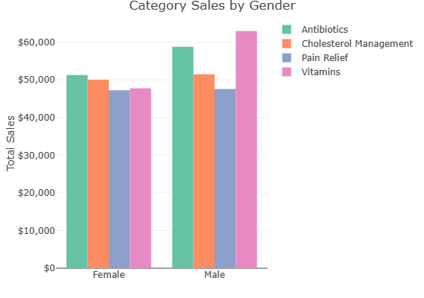
Analyzing gender-specific preferences within each category.
Analysis –
Categories like antibiotics and vitamins medicines are more popular among male
Sales distribution is almost equal w.r.t. category in females.
Recommendation -
Adjust product positioning and messaging based on gender preferences.
Develop products or marketing campaigns that specifically target the preferences of each gender within a category.

Slide 14
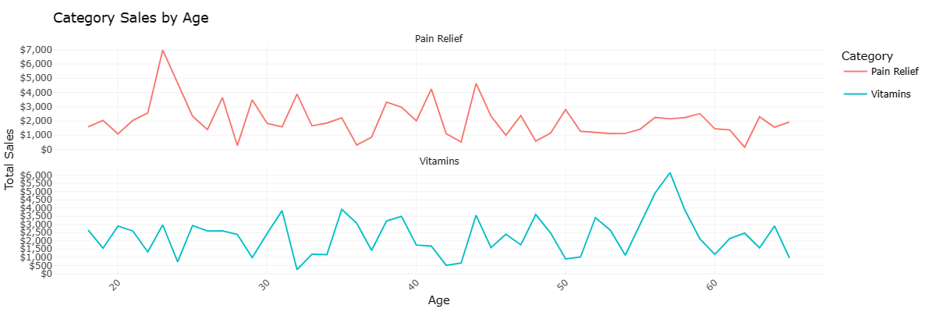
Sales variation across different age groups for different categories
Analysis –
Pain Relief sales are high between age group 20-30.
Vitamins sales are high between age group 55-60.
Recommendation –
Scope of customizing product offerings to cater to the preferences and needs of specific age groups.
Scope of launching age-specific formulations or packaging.

Slide 15
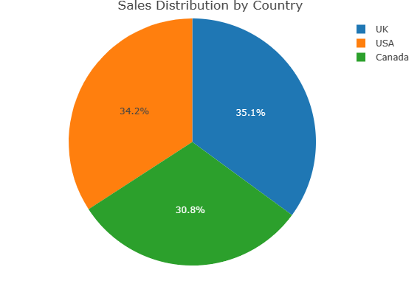
Determining geographical areas contributing the most to overall sales.
Analysis –
Sales distribution is almost equal w.r.t country.
Recommendation -
Optimize distribution channels and inventory management based on regional demand.
Tailor marketing and promotional activities to cater to the preferences and needs of customers in specific countries.

Slide 16
Conclusion
"Dashboard-driven insights optimize pharmaceutical strategy through real-time data analysis, guiding decisions in sales trends, product distribution, demographics, global expansion, R&D, pricing, supply chain, personalized medicine, and risk management for enhanced strategic development."

